Slide 1
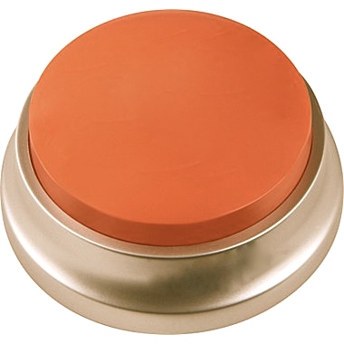

PUSHEY Button
https://sites.google.com/site/thepusheybutton
Pushey puts a button on anything to make your life simpler. Perform any task/action on your phone or tablet with a physical button.

Slide 2
What is IT?
Have you ever wished you had:
An external snooze button for your phone/tablet?
A button for a stopwatch or kitchen timer app?
Pushey solves your simple need by creating an external button that can be set up to perform a task on your tablet or mobile phone.
Simple design, simple to set up, simple to operate.

Slide 3

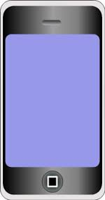
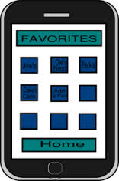
How it Works
1. Pair Pushey to your mobile phone or tablet.
2. Use App to select what Pushey does for you.
It’s that simple!

Slide 4
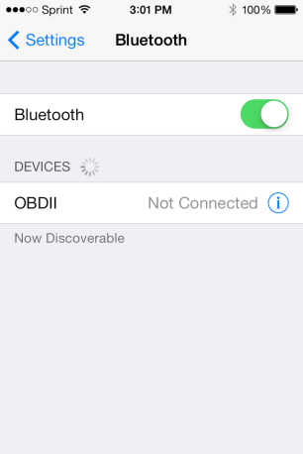
What you get
Pushey Button Free App Store Download
Businesses: We can personalize buttons with your name/logo!
Logo
Here

Slide 5
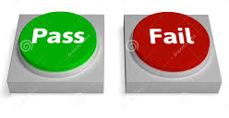

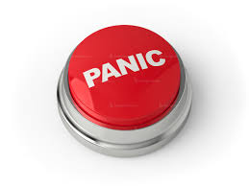
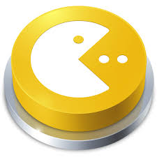
Sample Uses
Quiz Bowl
Snooze
Panic Alarm
Game Play

Slide 6
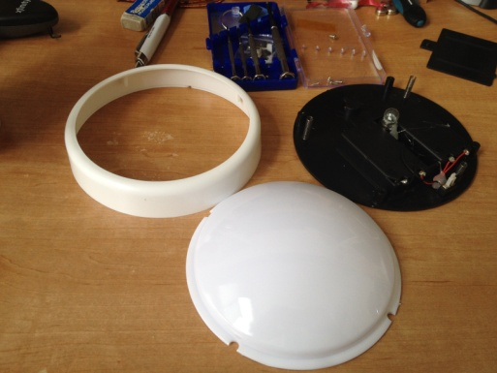
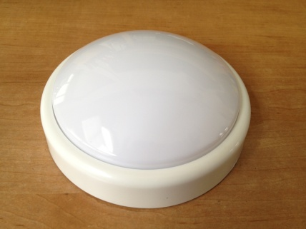
prototype
Pushey Button
MVP
Website: https://sites.google.com/site/thepusheybutton/

Slide 7
Want it?
Pre-order on our website (expected pre-Christmas delivery date)
Sponsor us in our upcoming kickstarter campaign.
Are you a developer or creative-type who loves to tackle problems hands-on? We are looking for talent. Come join team Pushey!
https://sites.google.com/site/thepusheybutton/

